Slide 1
Chapter 1 Classification
Wendy Chai

Slide 2
Topics
Characteristics of living things
Classification of living things
The five kingdoms and viruses
Classify animals (vertebrates and arthropods)
Classify plants (especially flowering plants)
Dichotomous keys
Drawing

Slide 3
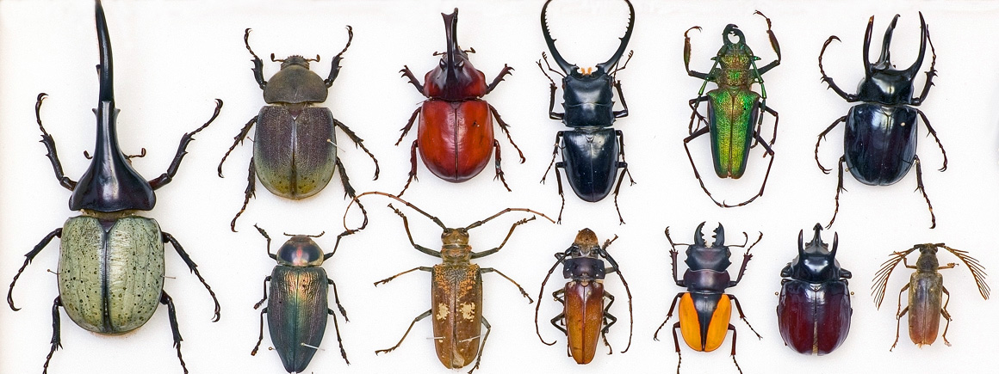
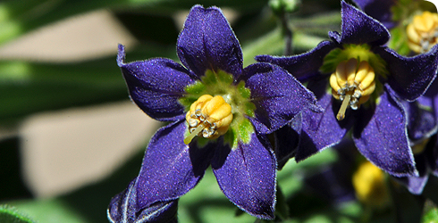
1. Characteristics of living things
Wendy Chai

Slide 4
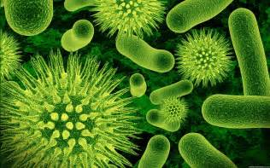
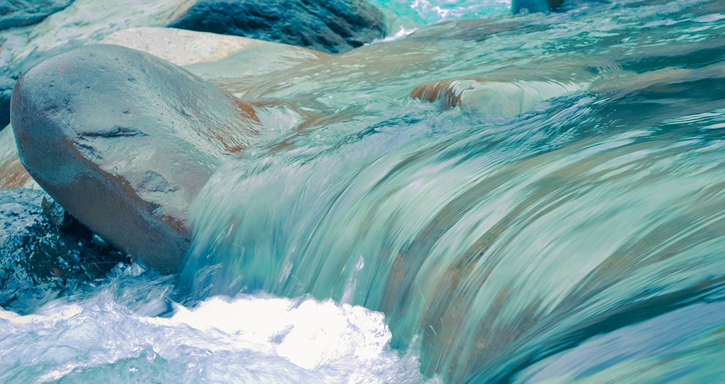
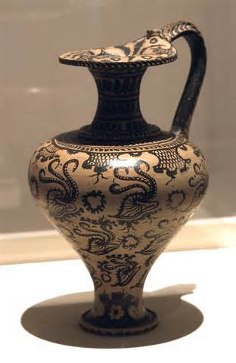
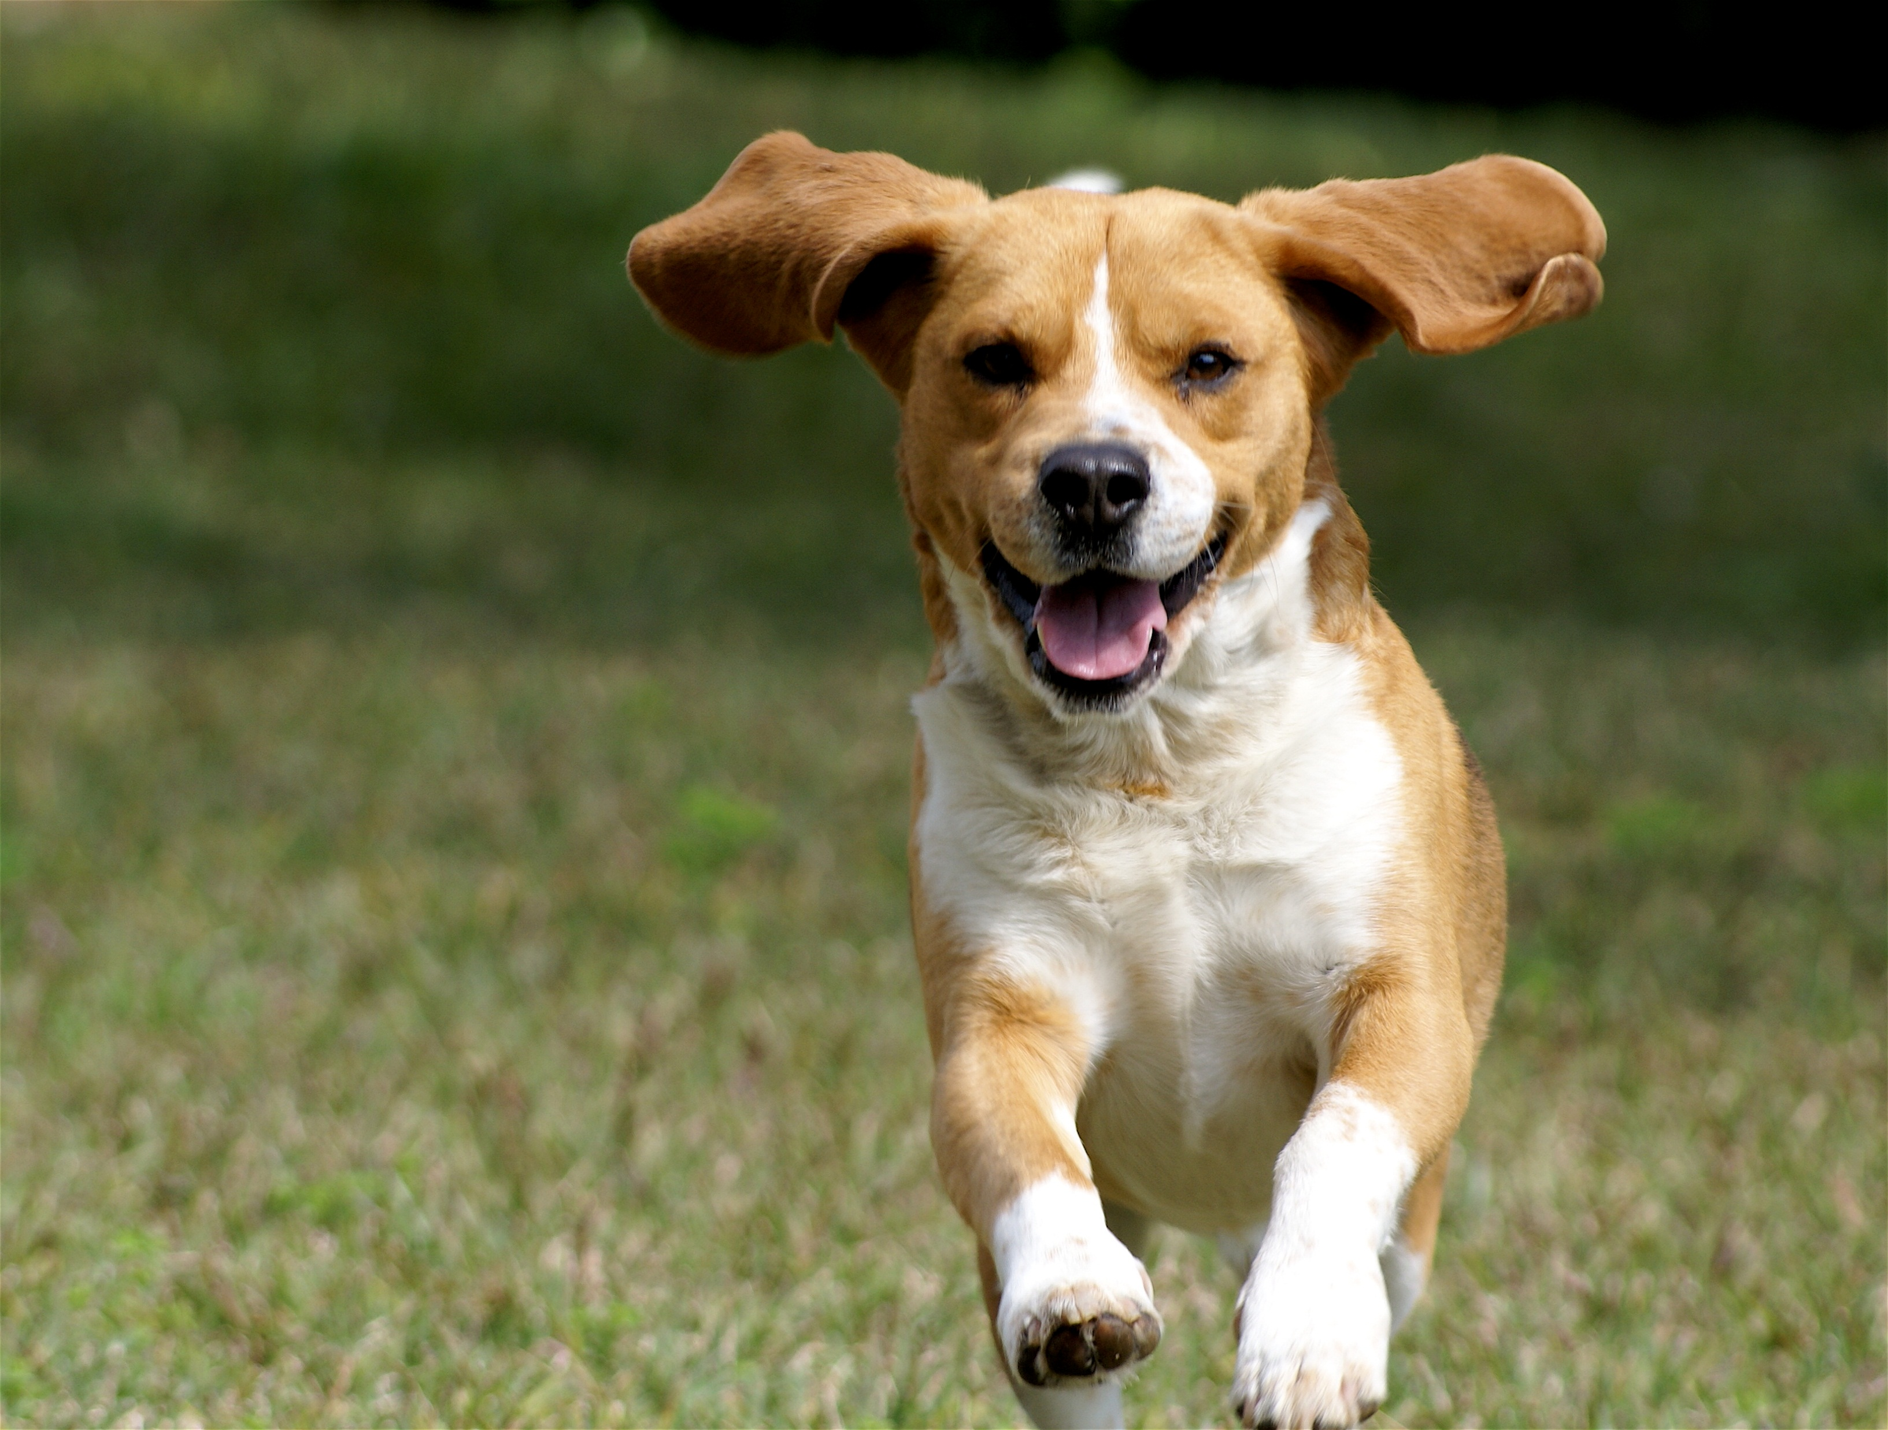
Characteristics of living things

Slide 5
Discussion
What makes living organisms living?/ How do we understand “living”
Please discuss with each other and work out a list of the characteristics/ features that all living things share.

Slide 6

Q: Page 2 OR Page 3?
A: Page 3!
Movement | an action by an organism or part of an organism causing a change of position or place
Reproduction | the processes that make more of the same kind of organism
Sensitivity | the ability to detect or sense stimuli in the internal or external environment and respond to changes in the environment
Growth | a permanent increase in size and dry mass by an increase in cell number (by cell division) or cell size or both
Respiration | the chemical reactions in cells that break down nutrient molecules and release energy for metabolism
Excretion | removal from organisms of toxic materials, the waste products of metabolism (chemical reactions in cells including respiration) and substances in excess of requirements
Nutrition | taking in of materials for energy, growth and development; plants require light, carbon dioxide, water and ions; animals need organic compounds and ions and usually need water

Slide 7
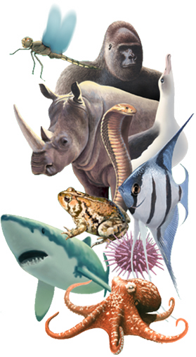

2. Classification?

Slide 8
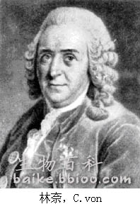
Classification
Carl Linnaeus (1707-1778)

Slide 9
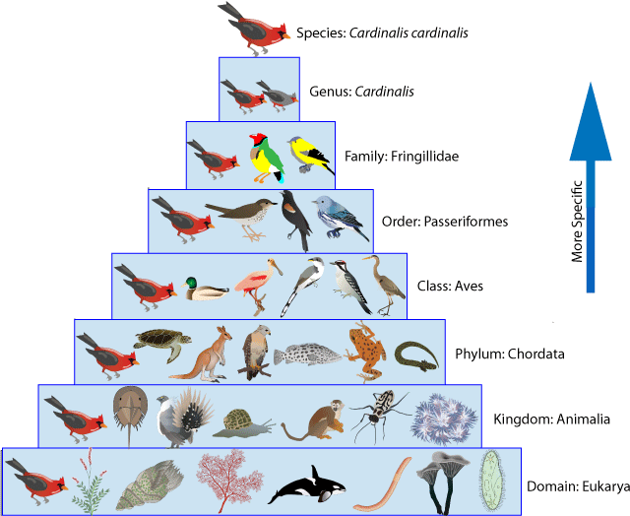
Example 1

Slide 10
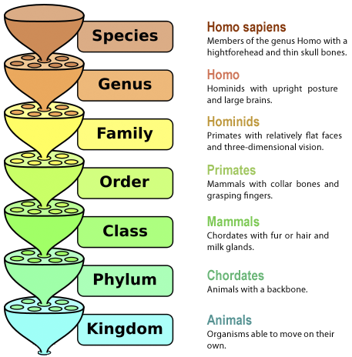
Example 2

Slide 11
Linnaean taxonomy
Plural | Singular | mnemonic
Kingdoms | kingdom | King | King
Phyla | phylum | Play | Phillip
Classes | class | Chess | Came
Orders | order | On | Over
Families | family | Fine | For
Genera | genus | Grain | Great
Species | species | Sand | soup

Slide 12
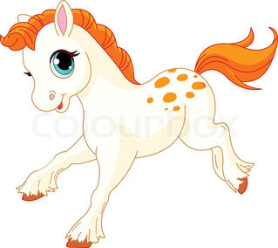
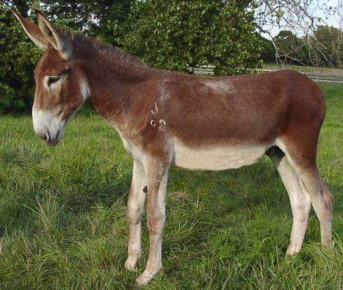
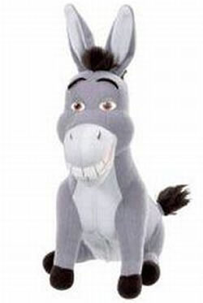
Most mules are infertile.
Species: a group of organisms that can reproduce to produce fertile offspring

Slide 13
Classification
Traditional groupings were based upon shared observable physical characteristics - studies of morphology and anatomy and intended to reflect natural relationships.
We now have new tools to help classifying as our knowledge expands. For example, DNA sequencing, unavailable in Linnaeus' time, has proven to be a powerful tool for classifying organisms.

Slide 14
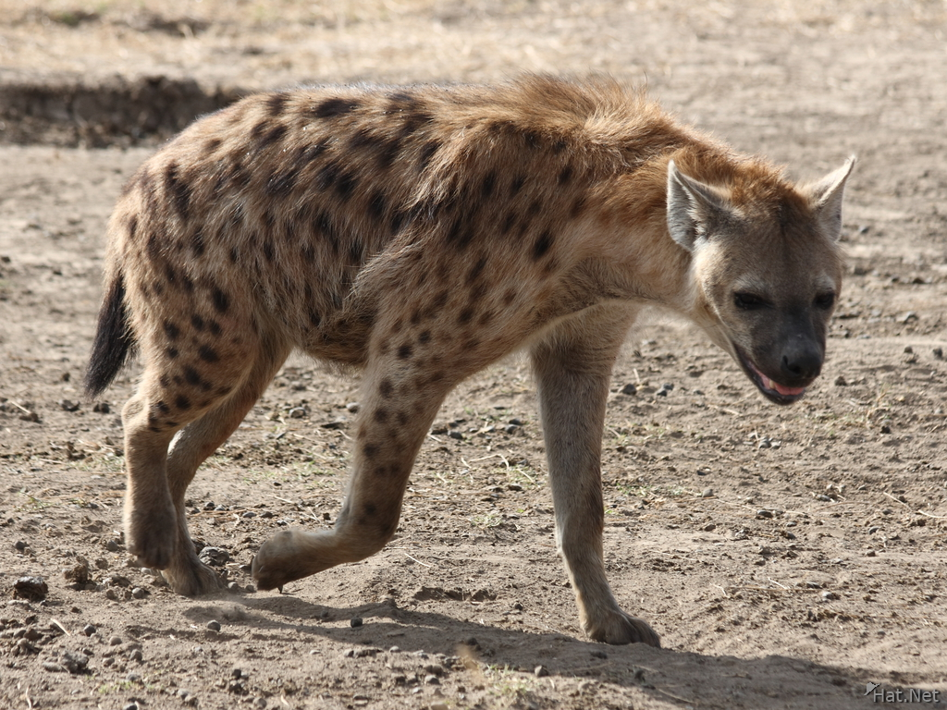
Canines (dogs)
hyena
Felines (cats)

Slide 15
Classification
Classification systems aim to reflect evolutionary relationships.
Organisms which share a more recent ancestor (are more closely related) have base sequences in DNA that are more similar than those that share only a distant ancestor.

Slide 16
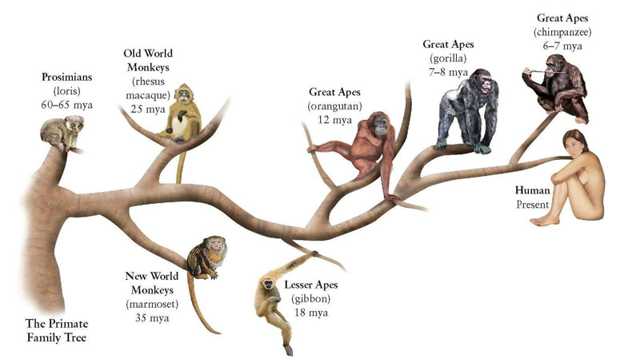

Slide 17

Binomial
Linnaeus laid the foundations for the modern biological naming scheme of binomial nomenclature
 | Definition
Binomial system | an internationally agreed system in which the scientific name of an organism is made up of two parts showing the genus and species

Slide 18
Binomial
Genus + species(Latin names for classification of all organisms)
Format: 1)The names are printed in italics. When you write one, you could use of italics or underlining
2) Genus with a capital letter and species with a lowercase letter
e.g. homo sapiens;
Homo sapiens (human);
?

Slide 19
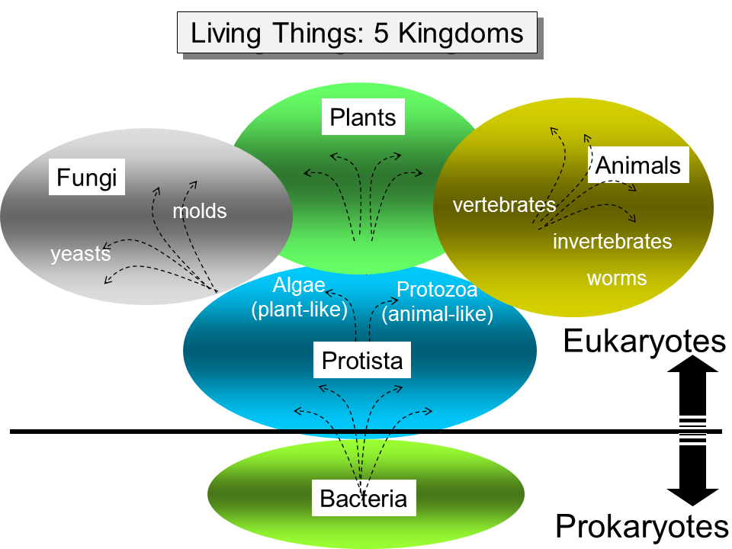
5 kingdoms
Virus?
All living things are placed in one of the five kingdoms.

Slide 20
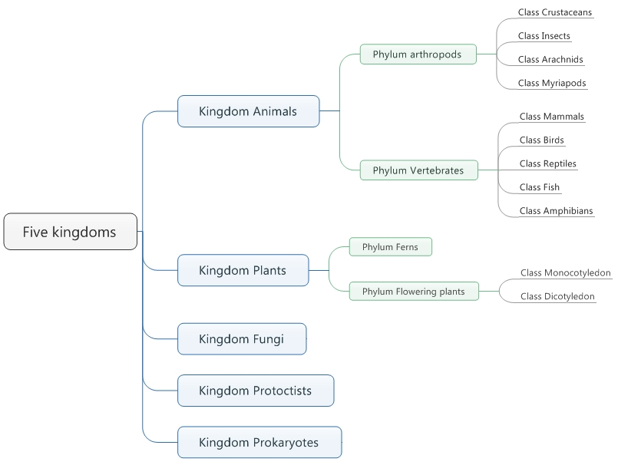
Virus

